Slide 1
Mini project Titanic Survival Prediction
-Surya P Nair

Slide 2
Problem statement :
The Titanic Problem is based on the sinking of the ‘Unsinkable’ ship Titanic in early 1912. It gives you information about multiple people like their ages, sexes, sibling counts, embarkment points, and whether or not they survived the disaster. Based on these features, you have to predict if an arbitrary passenger on Titanic would survive the sinking or not.

Slide 3
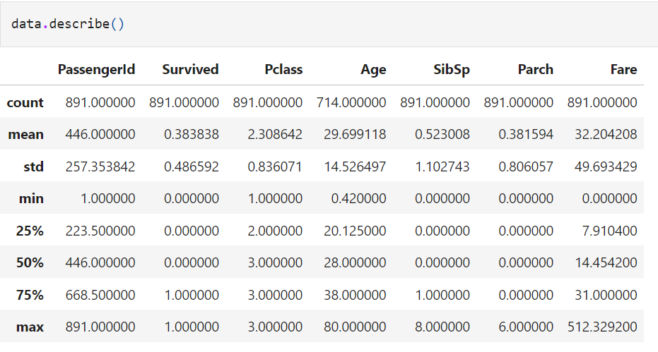
Exploratory Data Analysis (EDA):
The dataset contains 891 rows and 12 columns.
Statistics summary of the data is obtained using describe()

Slide 4
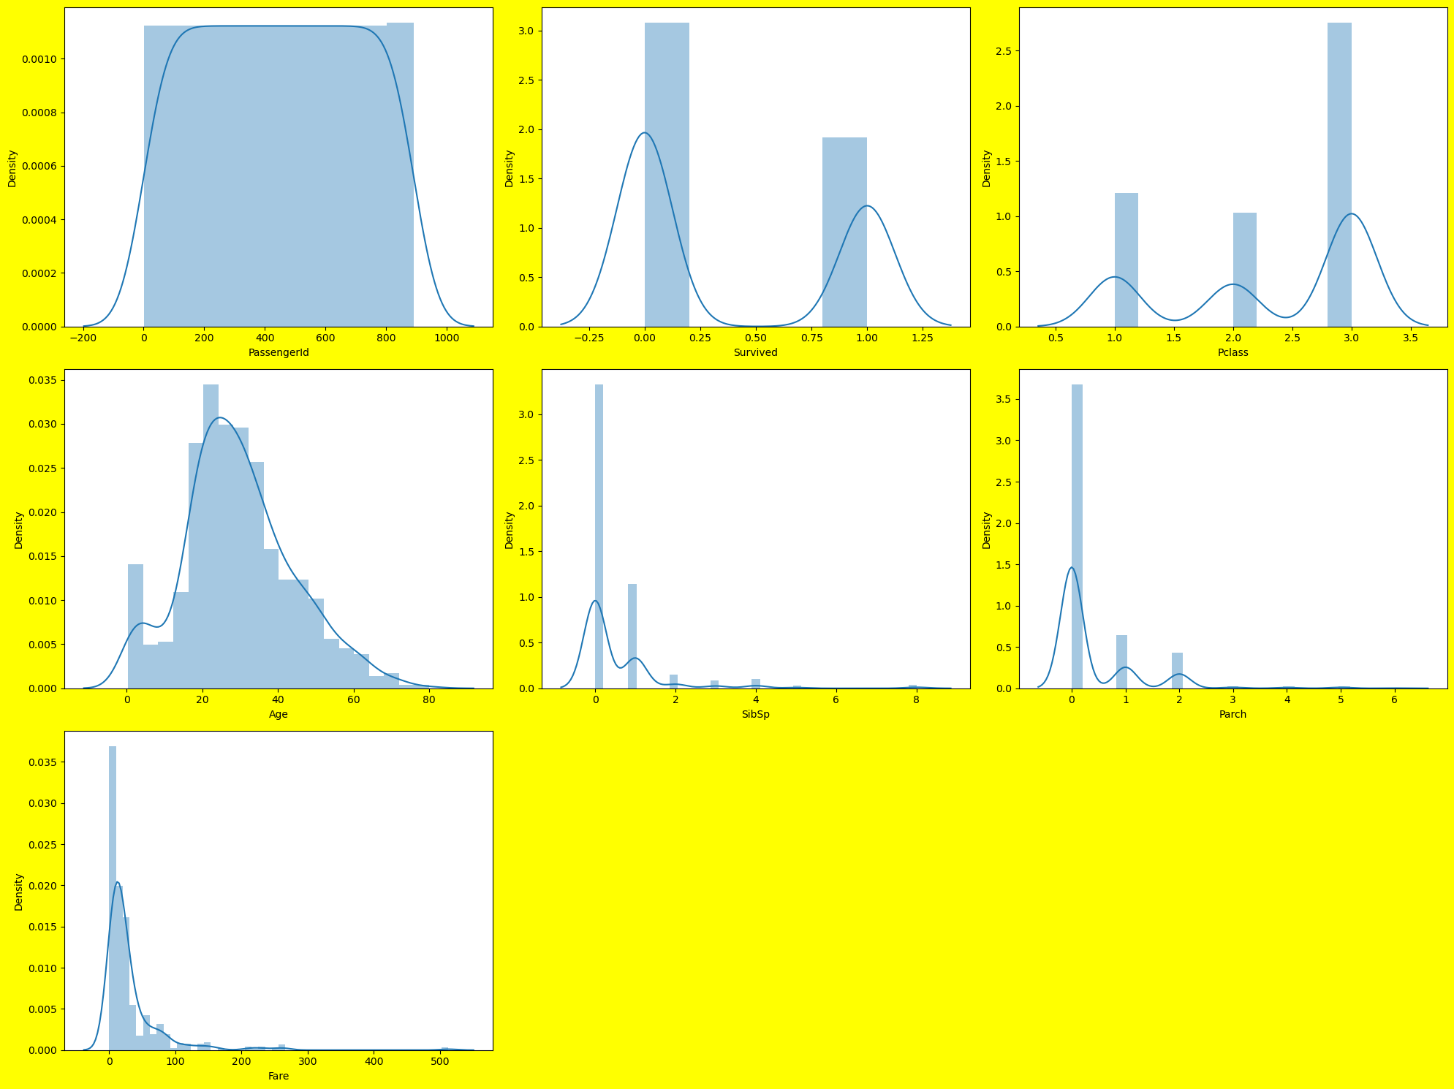
Data Distribution Plots :

Slide 5
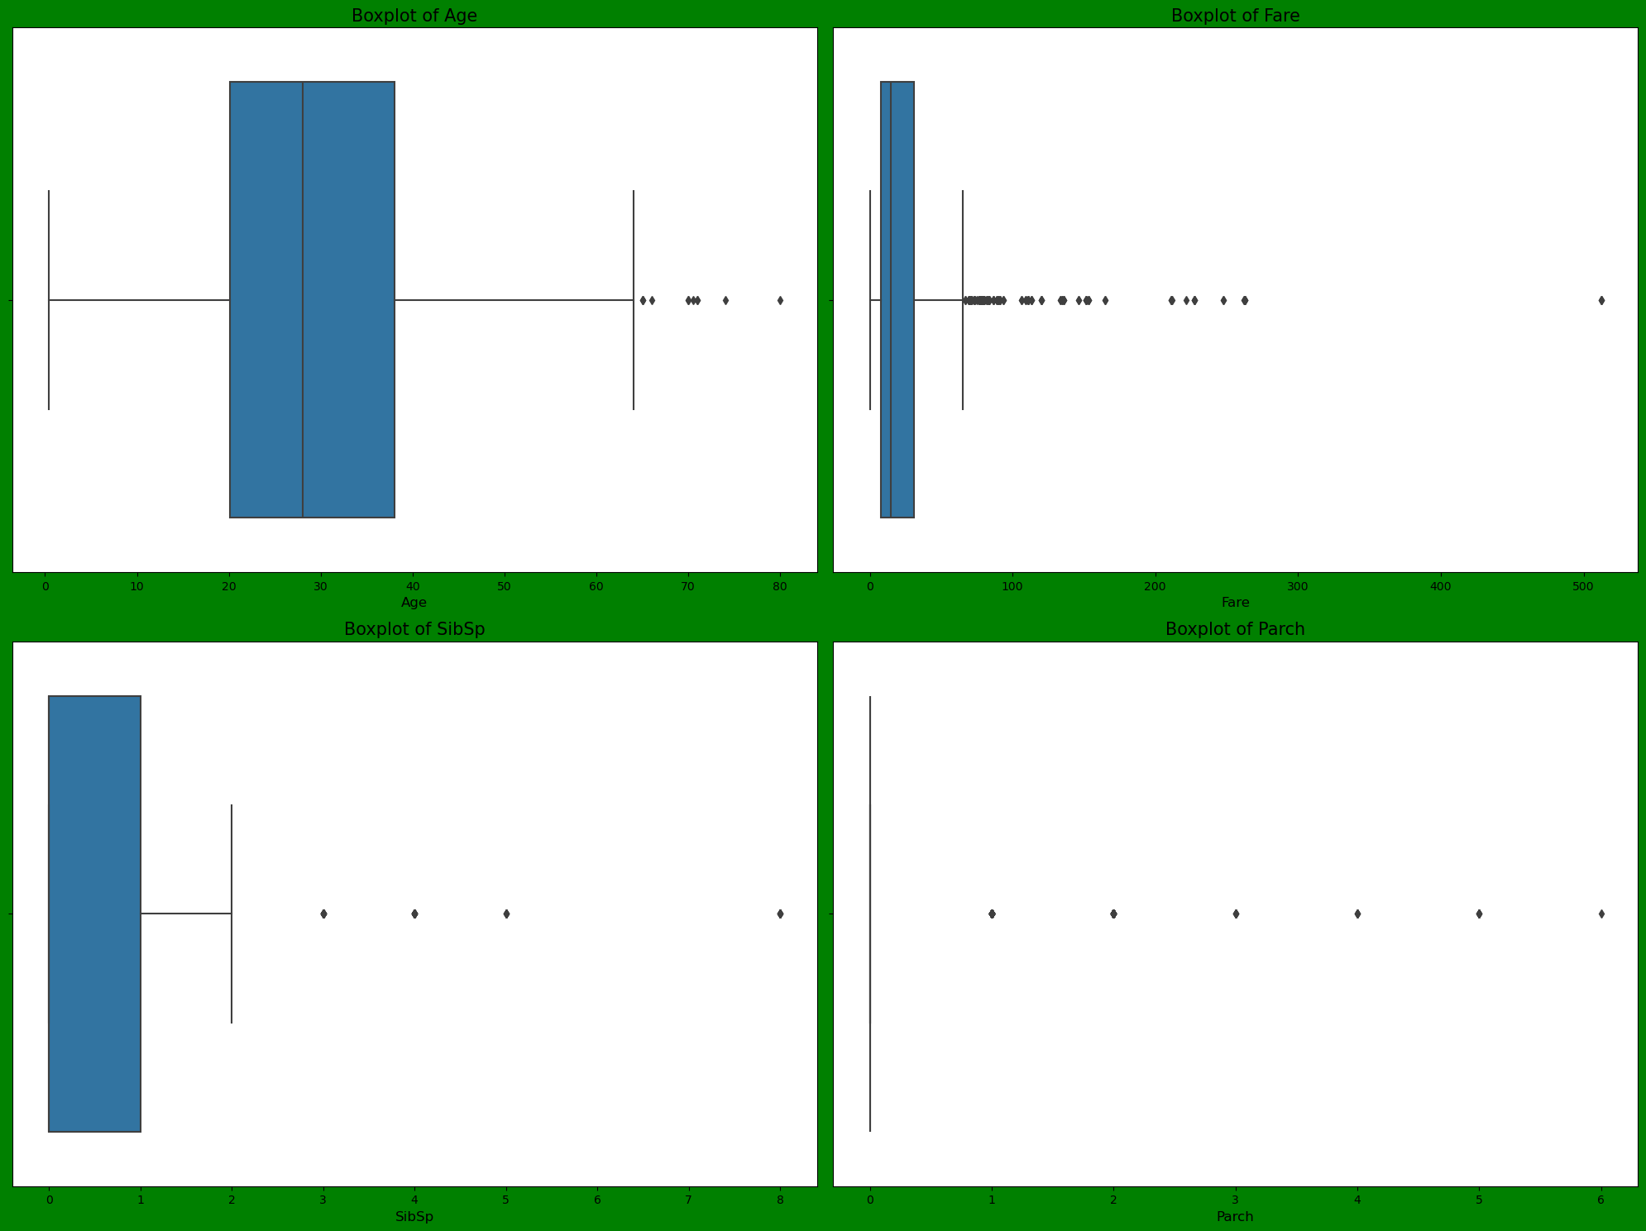
Outlier detection using boxplot for the columns such as Age, Fare, Sibsp and Parch

Slide 6
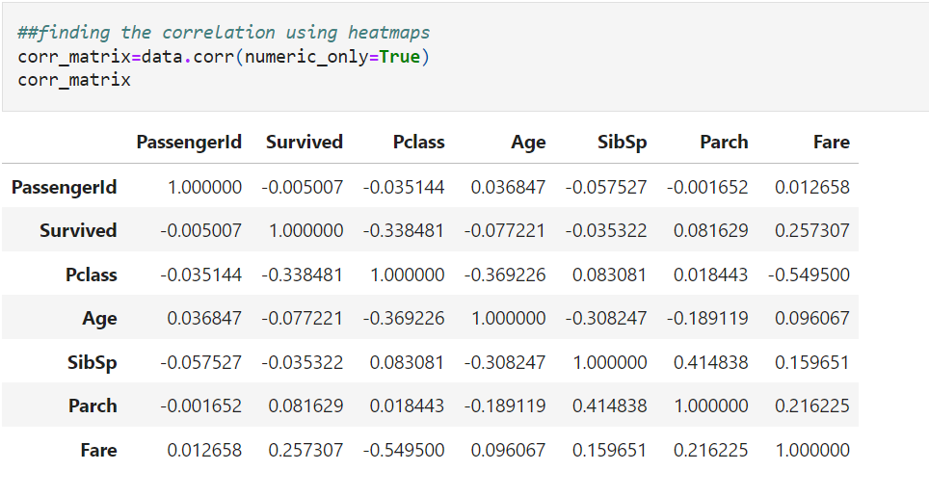
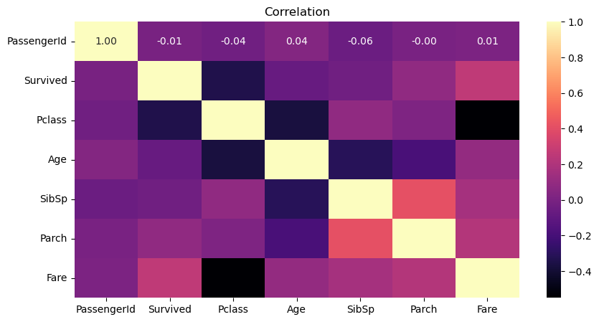
Correlation analysis using heatmap:

Slide 7

Data Preprocessing:
PassengerId','Ticket','Cabin
PassengerId','Ticket','Cabin
PassengerId','Ticket','Cabin
The missing values in the columns such as Age and Embark is filled using the fillna(). For Age column median() is taken and for Embark mode() is used
Columns such as PassengerId, Ticket and Cabin is deleted using the drop()
Outliers in the data are handled using the zscore()

Slide 8
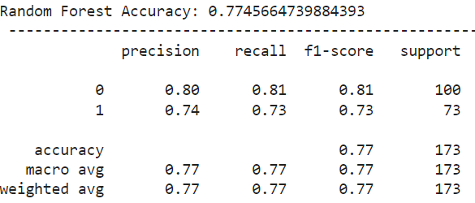
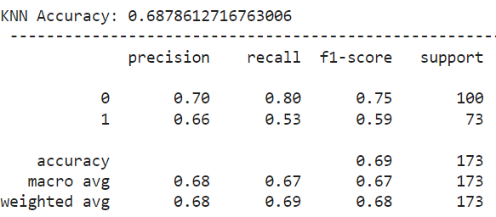
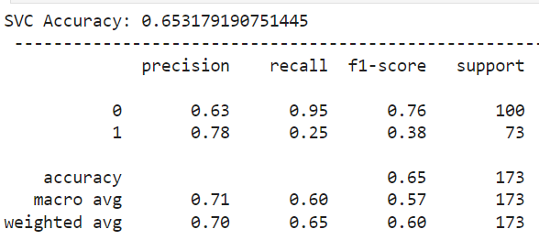
Model Prediction.
The algorithms used :
Random Forest algorithm
K-Nearest Neighbours algorithm
SVC (Support Vector Classifier)

Slide 9
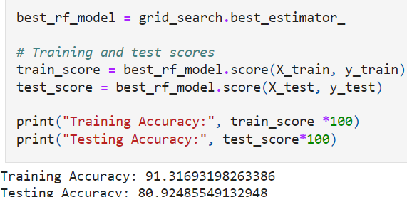
Best Model and Accuracy
Random Forest model has the best model and the accuracy is 83.35%
The training and testing score of Random forest model.

Slide 10
Thank You

